Slide 1
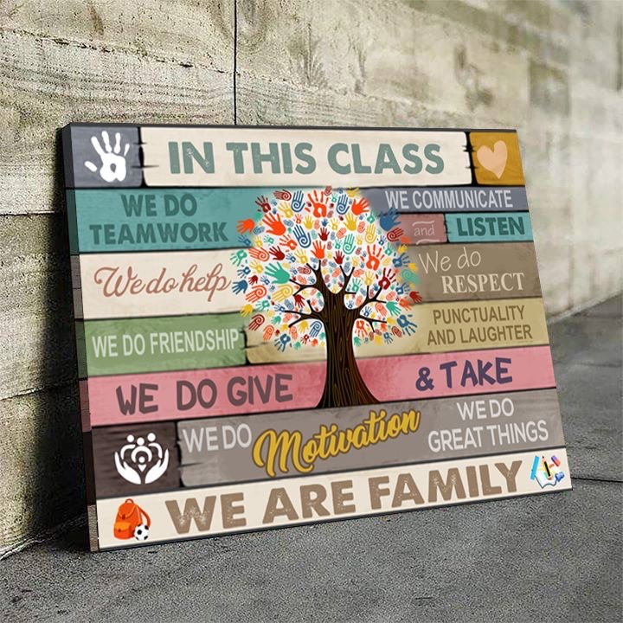

Slide 2
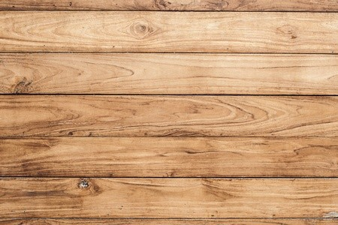




In This Class
We Do
Team Work
We Communicate
and Listen
We Do Help
We Do Respect
We Do Friendship
We Do Punctuality
The Future of the World is in
My classroom today

Slide 3
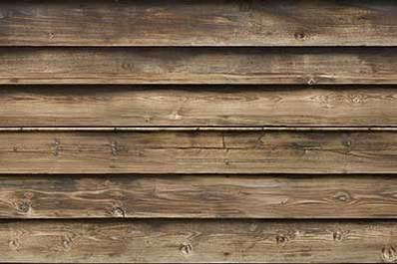

Slide 4


